Slide 1
CYBER CRIME AND SECURITY

Slide 2
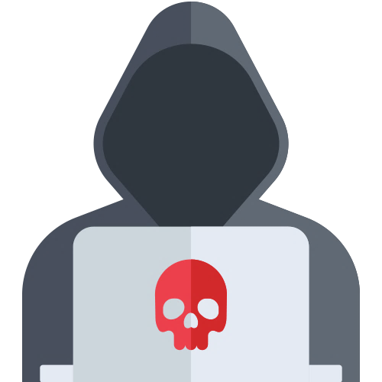
CYBER CRIME
Cyber crime is an activity done using computers and internet. We can say that it is an unlawful acts where in the computer either a tool or target or both.

Slide 3
HISTORY OF CYBER CRIME
The first cyber crime took place in 1820.
The first spam email took place in 1976 when it was sent out over the Advanced Research Projects Agency Network (ARPANET)
The first virus was installed on an Apple computer in 1982 when a high school student, Rich skrenta, developed the EIK cloner.

Slide 4
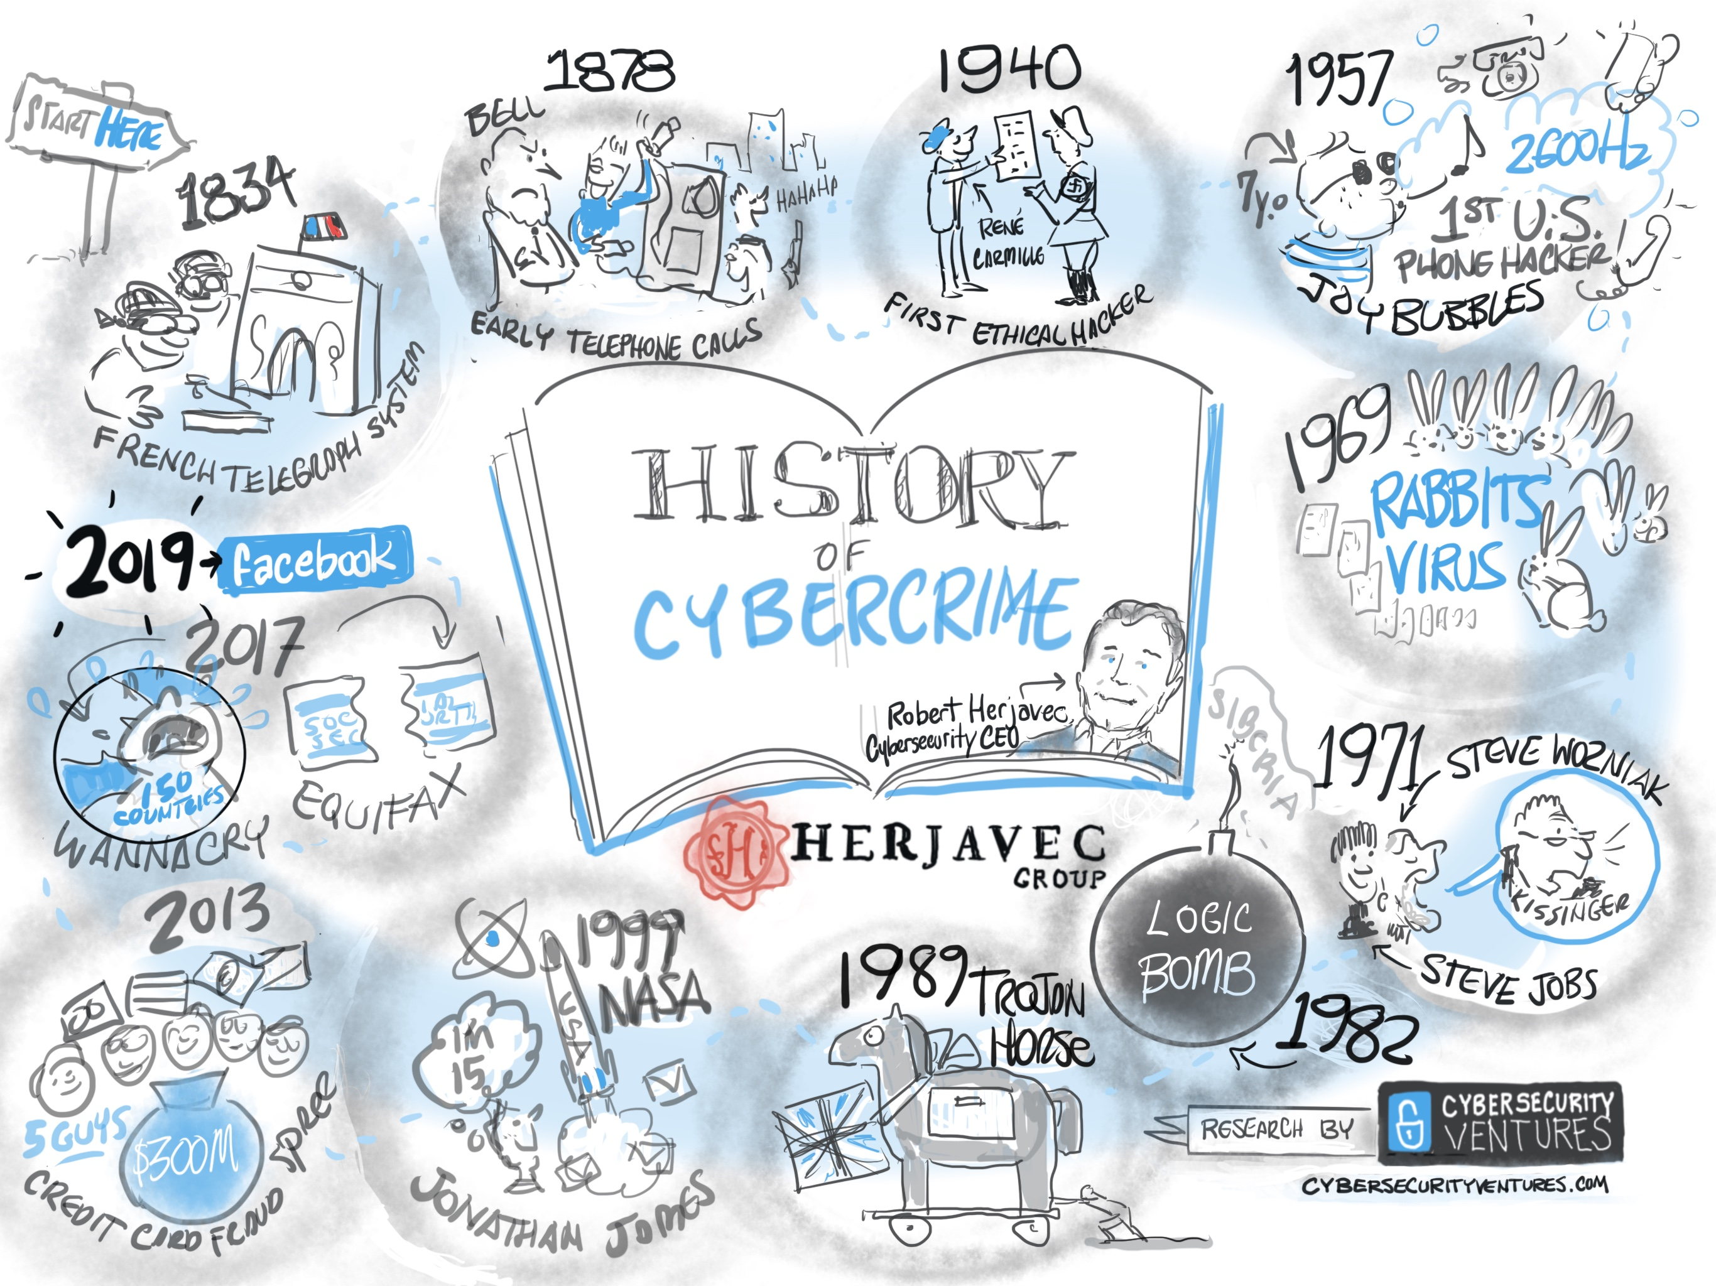

Slide 5
CATEGORIES OF CYBER CRIME
Computer as a target
a type of cyber crime in which computers are being attacked.
Computer as a weapon
a type of cyber crime in which computers are used for attacking.

Slide 6
COMPUTER AS A TARGET
Against person
This type of crime includes harassment using social media, and cyber stalking. Posting and distributing obscene material.
Against property
This type of crime includes unauthorized computer trespassing through internet, computer vandalism and transmission of harmful programs .
Against Government Cyber terrorism is one of cyber crime against government. As the internet is growing with cyber space used by individuals and groups to threaten the government as also to terrorize the citizens of country.

Slide 7
COMPUTER AS A WEAPON
Using computer as a storage devices
This type of crime computer is used as a passive storage medium like to store stolen passwords lists, credit card details and obscene material.
Using computer as a communication tools
Most of the crimes fall into this category that are committed online like sales of guns, gambling, etc.

Slide 8
CYBER THREAT EVOLUTION
Virus
Malicious code (Mellisa)
Identity Theft
(Phishing)
1977
1995
2000
2003-04
2005-06
2007-08
Breaking websites
Advanvced worm
(I LOVE YOU)
Black is the color of ebony and of outer space

Slide 9
CYBER THREATS
Do not click on any emails that arrive by illegitimate source.
Pay attention to the warnings your browser in flashing.
Backup your computer and settings regularly.
Have a different unique password for every account.
Change your passwords often.
Be conscientious of what you plug into your computer.

Slide 10
SAFETY TIPS TO PREVENT
Use antivirus software.
Insert firewalls.
Uninstall unnecessary software.
Maintain backup.
Check security settings.
Stay anonymous.
Never give your full name or address to strangers.
Learn more about internet privacy.

Slide 11

CYBER SECURITY
Cyber Security involves protection of sensitive personal and business information through prevention, detection and response to different online attacks. Cyber security actually preventing the attacks

Slide 12
ADVANTAGES OF CYBER SECURITY
The cyber security will defend us from critical attacks.
It helps us to browse the website.
Internet security process all the time incoming and outgoing data on your computer.
It will defend us from hacks and virus.
Application of cyber security used in our PC needs update every week.

Slide 13

THANK YOU!

